Slide 1
Google Cloud Project

Slide 2
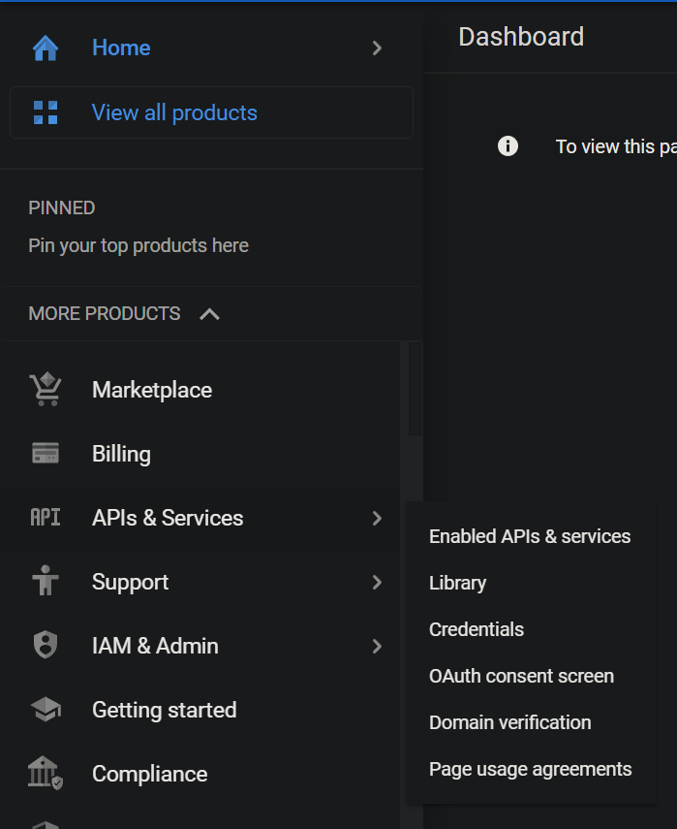
Go to Google Cloud Console
https://console.cloud.google.com/
Expand “MORE PRODUCTS”, hover on “APIs & Services”, and click “OAuth consent screen”

Slide 3
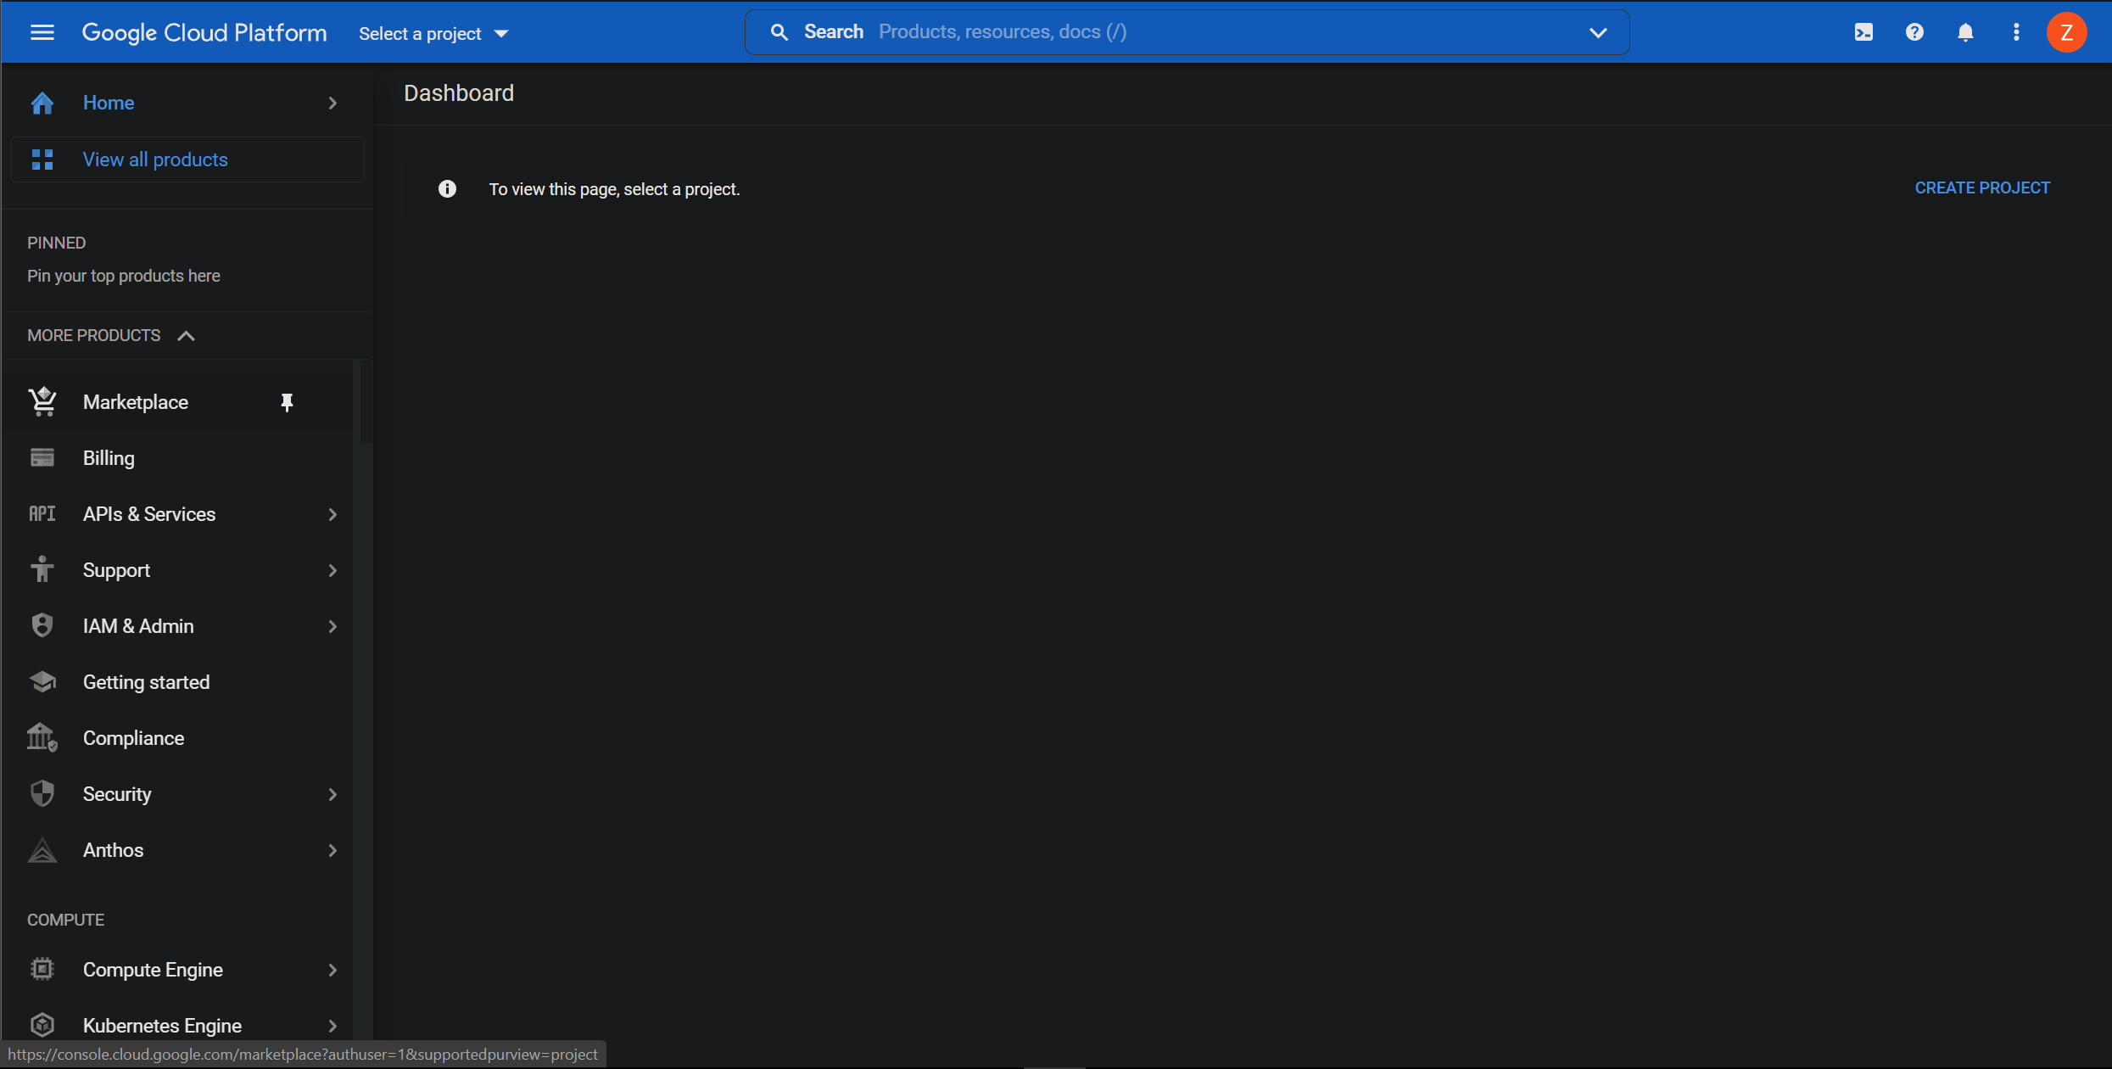
Click “CREATE PROJECT”

Slide 4
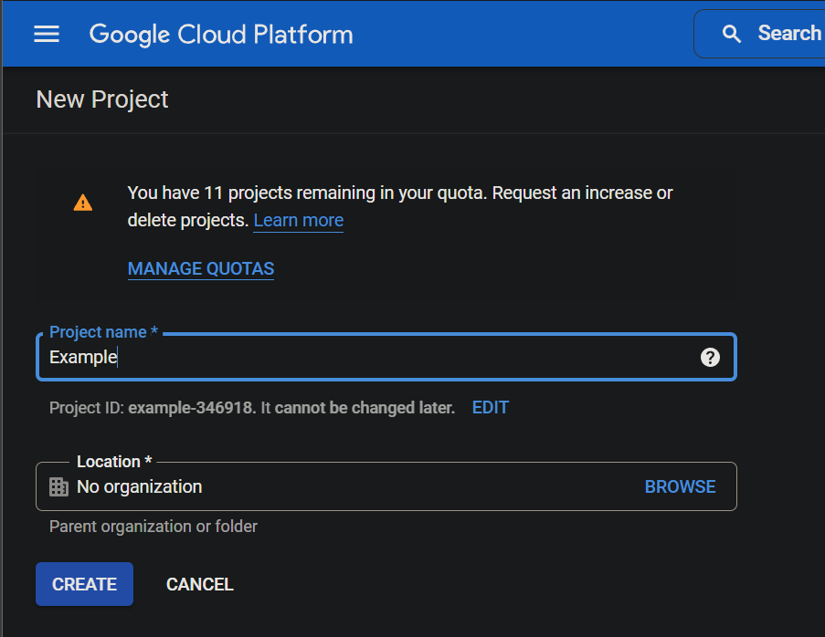
Enter project name and location
If not using a CS email then you can leave location as “No organization”
Click CREATE
Wait for a few minutes for the project to be created

Slide 5
Select the new project
Again, expand “MORE PRODUCTS”, hover on “APIs & Services”, and click “OAuth consent screen”

Slide 6
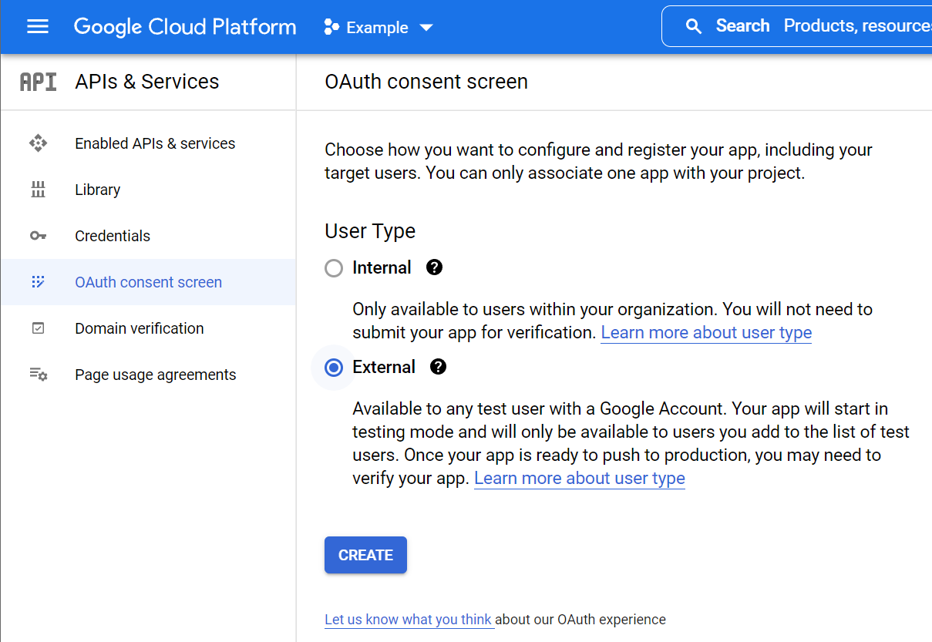
Select “External” under “User Type”, click CREATE

Slide 7
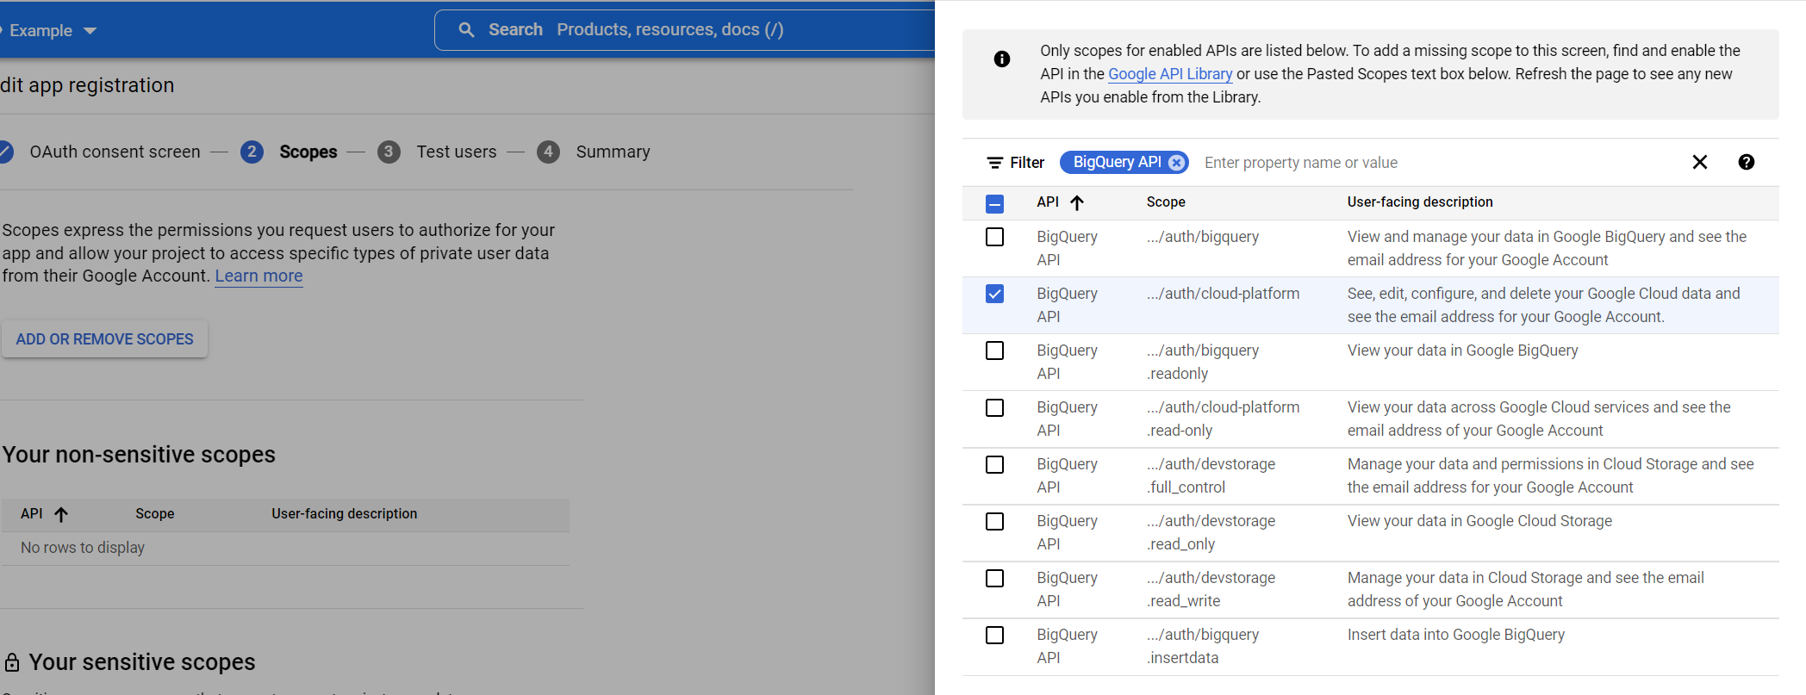
Fill in required information
When you get to Scopes, click “ADD OR REMOVE SCOPES”, search for “BigQuery API”, and select the one with Scope “../auth/cloud-platform”, then click UPDATE

Slide 8
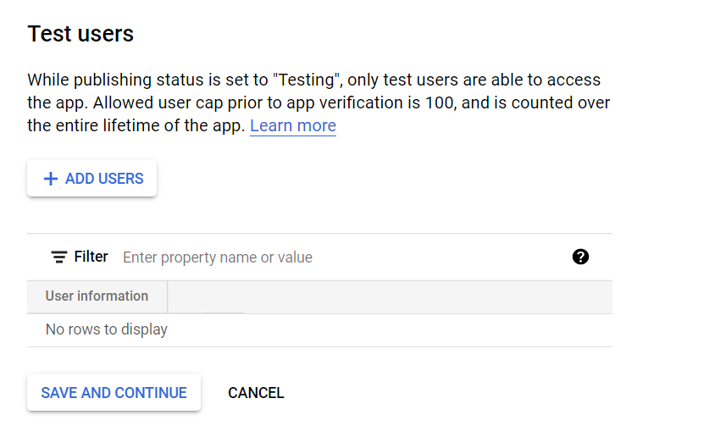
Add users that you want give access to by add their gmail

Slide 9
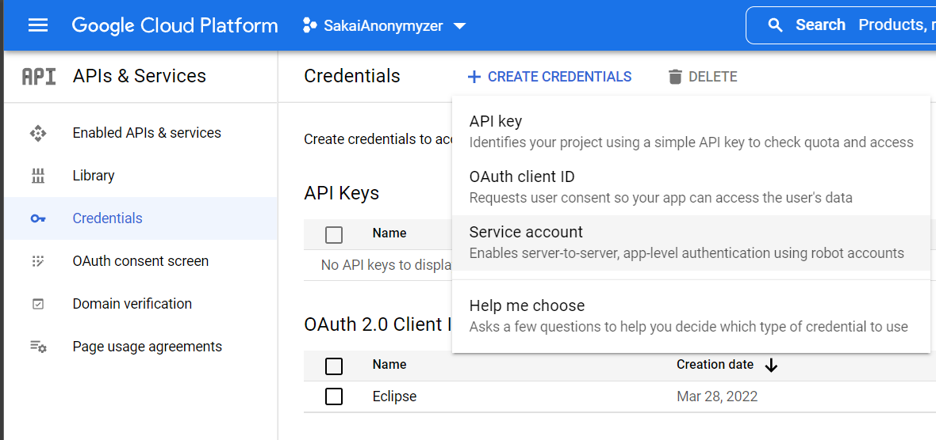
Go to Credentials on the left, click “CREATE CREDENTIALS”, and select “Oauth client ID”

Slide 10
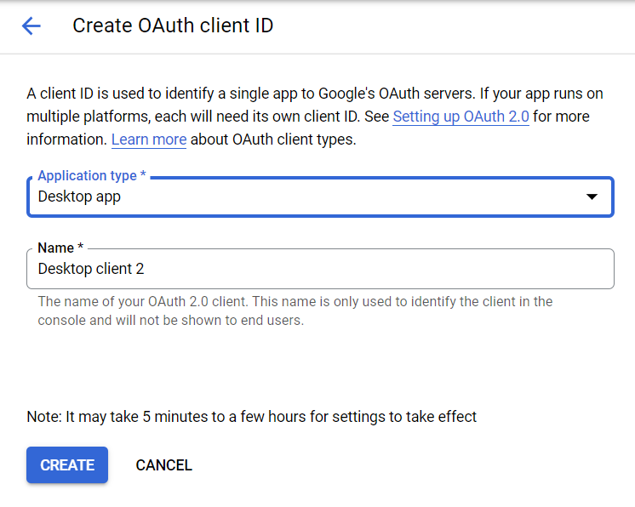
Select “Desktop app” for Application type and give it a name, then click CREATE

Slide 11
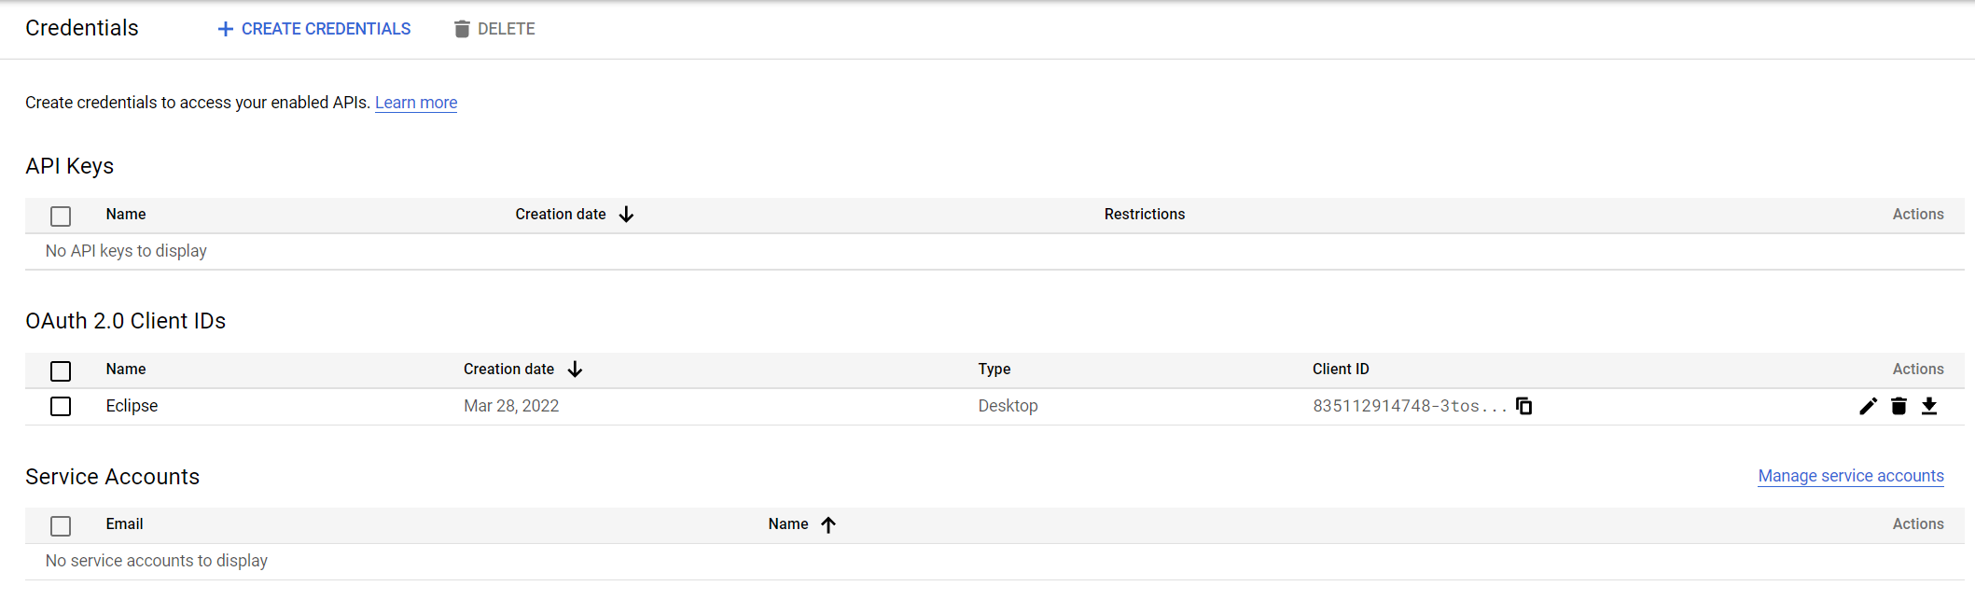
After creating the credential, go back to Credentials, and download the JSON credential

Slide 12
Rename the downloaded JSON file “credentials.json”
Put the file in PROEJCT_PATH/src/main/resources
Alternatively, you can change change the string constant CREDENTIALS_FILE_PATH in PROJET_PATH/src/main/java/DriveAPI.java to match the file path and name

Slide 13
Wait a few minutes for the credential to be effective
Then you should be able to run the program and log in with any google accounts added as test users

